Slide 1
Chemistry Basics
All of the matter in the universe (what we call “stuff”) is made of just about _______ different kinds of _______.
Everything in your world is made up of simple ___________________ of these basic building blocks called atoms.
Chemistry is the study of how these atoms combine and the products they create.

Slide 2
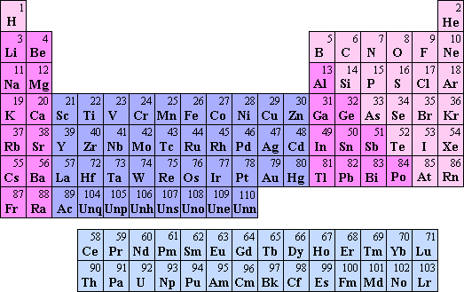
The Periodic Table
Contains almost all of the information about all of the elements on one page.

Slide 3
Reading The Periodic Table
Each box on the periodic table represents a different element
It contains vital information about the element
________Number
6 C Carbon 12.011
__________Symbol
Element Name
Atomic ________

Slide 4
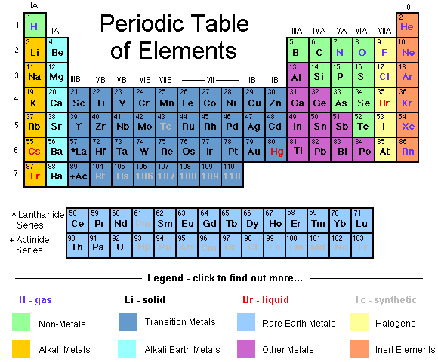

Slide 5
Practice:
Warm-up Questions:
Element name for the symbol “P”
Symbol for the element “Potassium”
Atomic number for the symbol “Ag”
Atomic mass for “Gold”
First 20 Elements Worksheet
Only complete Day #1 information:
Number, Symbol, Name, & Atomic Mass
Questions #1, #2

